Slide 1


Slide 2














Welcome to the Annual
Food & Drink Conference!

Slide 3

Robert Elliot
Director of of Business Engagement and Policy, Herefordshire & Worcestershire
Chamber of Commerce

Slide 4
Hannah Taylor
Senior Associate, Agriculture and Rural Affairs
Team at mfg Solicitors

Slide 5
Samantha Vaughan
Co Owner of Dewsall Court

Slide 6


Slide 7
Bradley Yarrington
CEO and Founder Brose Wine

Slide 8
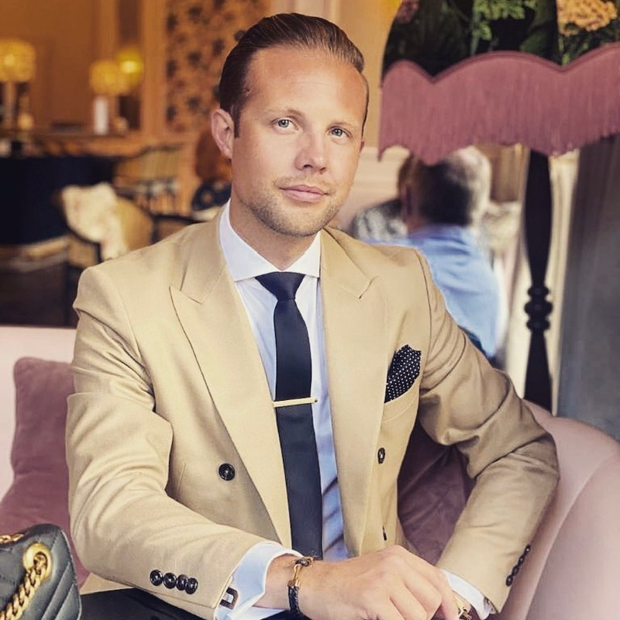
BRADLEY YARRINGTON - FOUNDER & CEO – BROSÉ & BROSKI. LTD
Having successfully created Brosé, brought investors on board and scaled the company, Bradley has a proven track record in creating alcohol brands and taking them to market. His previous digital advertising experience in managing marketing campaigns for some of the world’s largest alcohol brands goes hand in hand with Bradley’s combined skill set.
From the success of Brosé, Bradley has set his sights on creating a larger alcoholics drinks portfolio. Including the recently launched Broski. There will also be a green agave-based tequila called Broquila, and a Vodka spirit named Brodka. Giving a total of four alcohol brands within the Bro drinks group.
Bradley’s vision and exit plan, is to build up the brands across the board and look to sell them to a large conglomerate such as Diageo, Pernod Ricard or Heineken Star Group in the future.
1

Slide 9

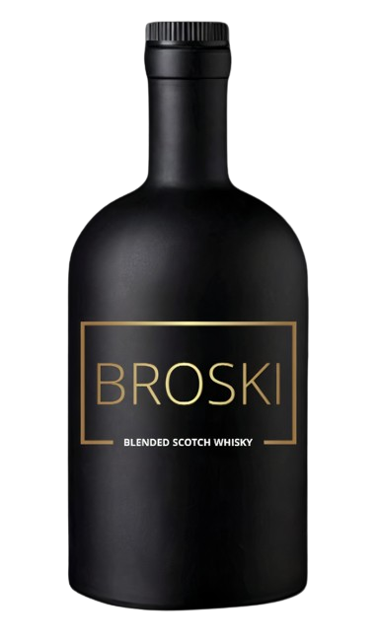


CURRENT BRANDS - BROSÉ AND BROSKI
2

Slide 10
TOPICS – P1
MY BACKGROUND
HOW I HAD THE IDEA OF BROSÉ – TRADEMARKS, DOMAIN, SOCIAL HANDLES
SOURCING BROSÉ – AIX EN PROVENCE – Grenache, Syrah, Cinsault, Cabernet Sauvignon, Rolle
HOW I LAUNCHED BROSÉ ONLINE DURING THE 2019 LOCKDOWN
BROSÉ IMPORT / EXPORT - Provence (Marseille) - UAE (Jebel Ali) – ES (Alicante) – NL (Rotterdam) – PT (Lisbon)
CREATING AND SOURCING BROSKI FROM THE SCOTTCH HIGHLANDS, LOCH LOMOND
3

Slide 11
TOPICS – P2
ECOMMERCE, STORAGE AND FULFILMENT – SPOTIFY, FIDELITY
ON TRADE - UK DISTRIBUTION – LWC, INN EXPRESS, SWALLOW DRINKS
OFF TRADE - SUPERMARKETS - WAITROSE DISCUSSIONS
PLANS FOR FUTURE BRO BRANDS – BROQUILA AND BRODKA. THE BRO DRINKS GROUP – SASMA BV
COMPANY EXIT STRATEGY – DIAGEO, HEINEKEN, PERNOD RICARD
3

Slide 12


FUTURE BRANDS - BROQUILA AND BRODKA
4

Slide 13
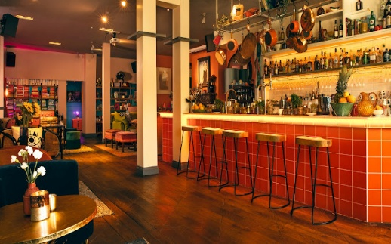
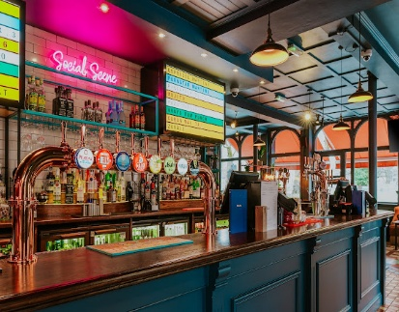
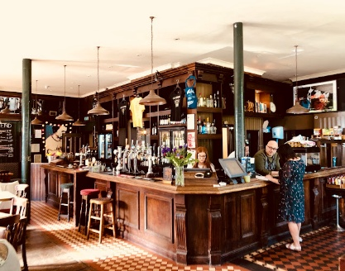
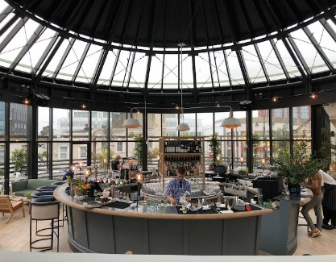
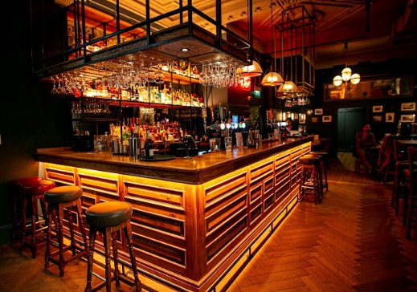
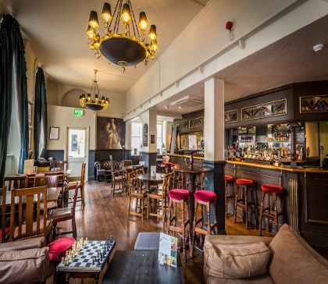
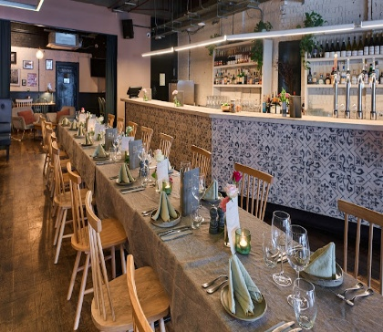
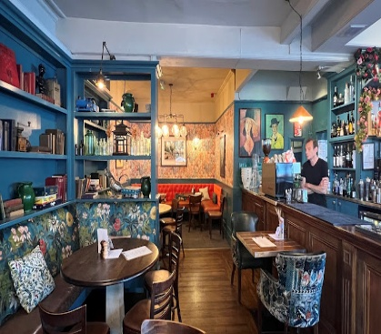
UK – LONDON MARKET LISTINGS – BROSÉ AND BROSKI
The Little Orange Door
The Sindercombe Social
The Three Stags
601 Queen’s Road
The Black Horse
The Duchy Arms
SW16 Bar & Kitchen
The Fentiman Arms
3 BROSKI

Slide 15



Refreshment Break and Networking

Slide 17
Kelly Mawman
Operations Manager at Tyrrells / KP Snacks

Slide 18
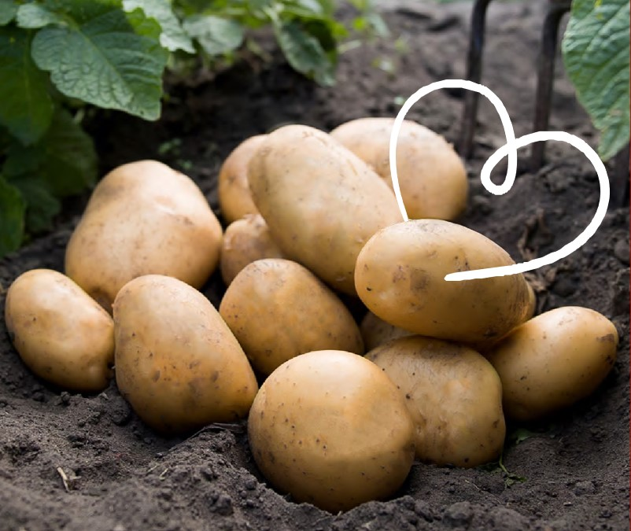

<insert job title>
KP Snac ks
Home of Tyrrells Crisps
Kelly Mawman
Operations Manager

Slide 19




POST
Purpose
Sharing a company update
Sharing challenges and successes
Outcomes
Knowledge build around KP Snacks
Alignment/ support from other local companies on shared interests
Structure
Presentation and discussion
Time
30 (ish) minutes

Slide 20
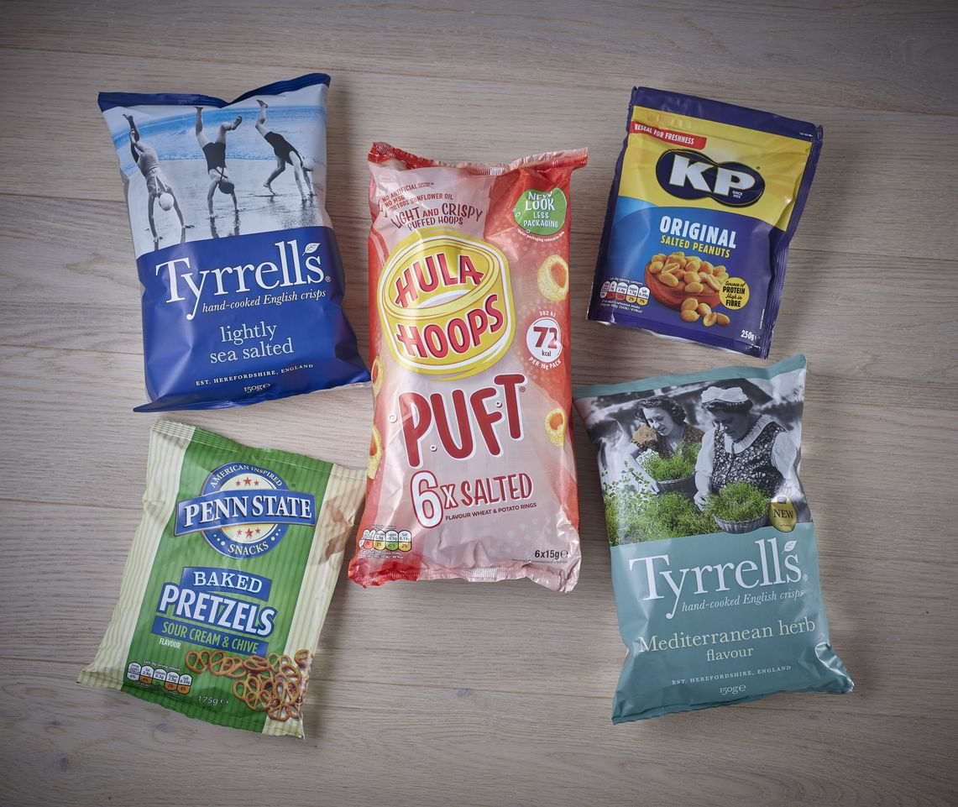
About us – KP Snacks
KP is home to some of the most iconic British snack brands and also produces all kinds of snacks for the UK’s retailers.
We have been making ‘Happy Snacking Moments’ for decades, creating exciting snack ideas that meet the changing tastes and expectations of our customers and consumers.
KP Snacks is also proud to be part of the Intersnack Group, which was founded in Germany more than sixty years ago and made its first potato chips in 1968.
Since then, it has grown and flourished to become a market leader in savoury snacks, now present in over 30 countries across Europe, Australia, New Zealand and beyond.

Slide 21
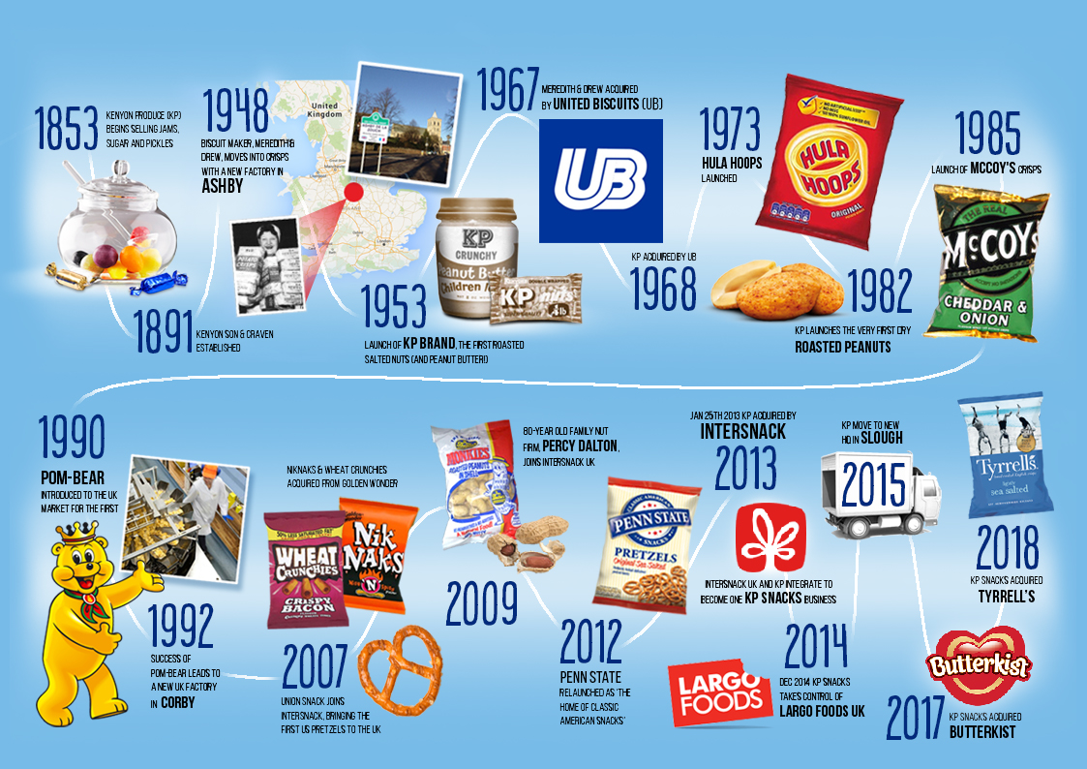
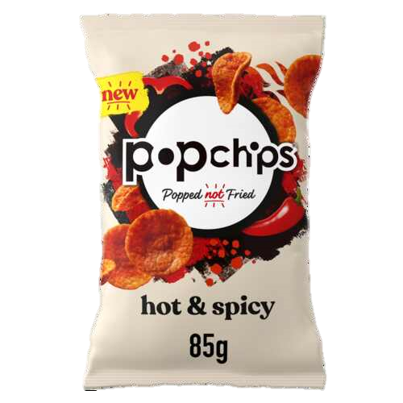
Our journey
AND POPCHIPS
Notes:
The company was founded in 1853 as Kenyon & Son as a producer of chocolate and sweets, jam and pickles.
The company switched to producing roasted and salted hazelnuts in 1948, expanding to peanuts later. These were originally produced for sale in cinemas.
In 1953 the No.1 KP Nuts peanut brand.
The company became part of United Biscuits (UB) in 1968 and then was sold again to German company Intersnack (who are our current parent company) in December 2012 for £500 million.
The Butterkist brand was bought in 2017 and Tyrrells and Popchips joined in 2018.

Slide 22



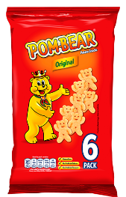
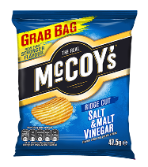
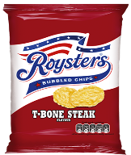

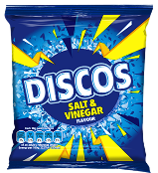
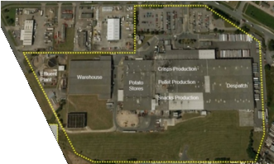
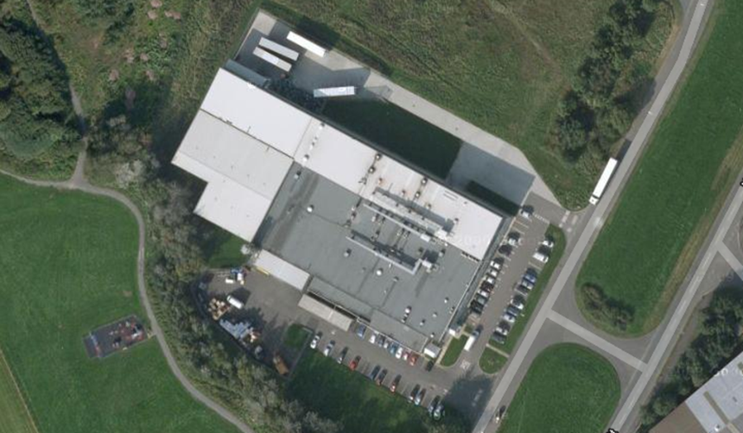


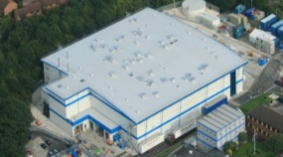

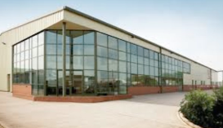
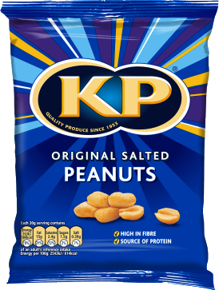
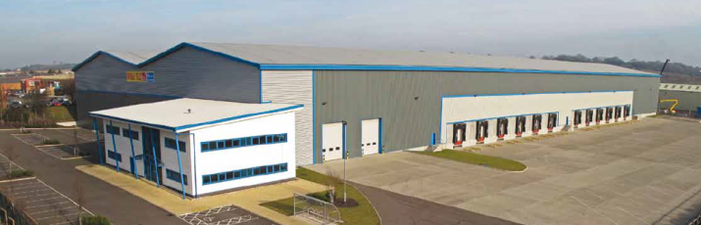

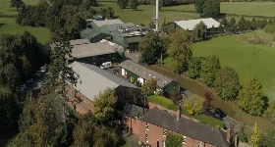

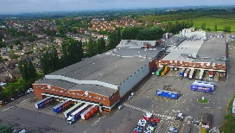
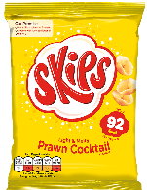
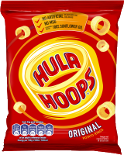
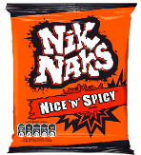
Our Sites
Teesside
Tanfield
Pontefract
Uttoxeter
Hellaby
Central Communications
Finance, IT & Legal
HR
Marketing
Sales
Leominster
Ashby
Slough
Notes:
KP have 8 sites including head office in the UK, with each site specialising in certain KP brands and private label products.

Slide 23
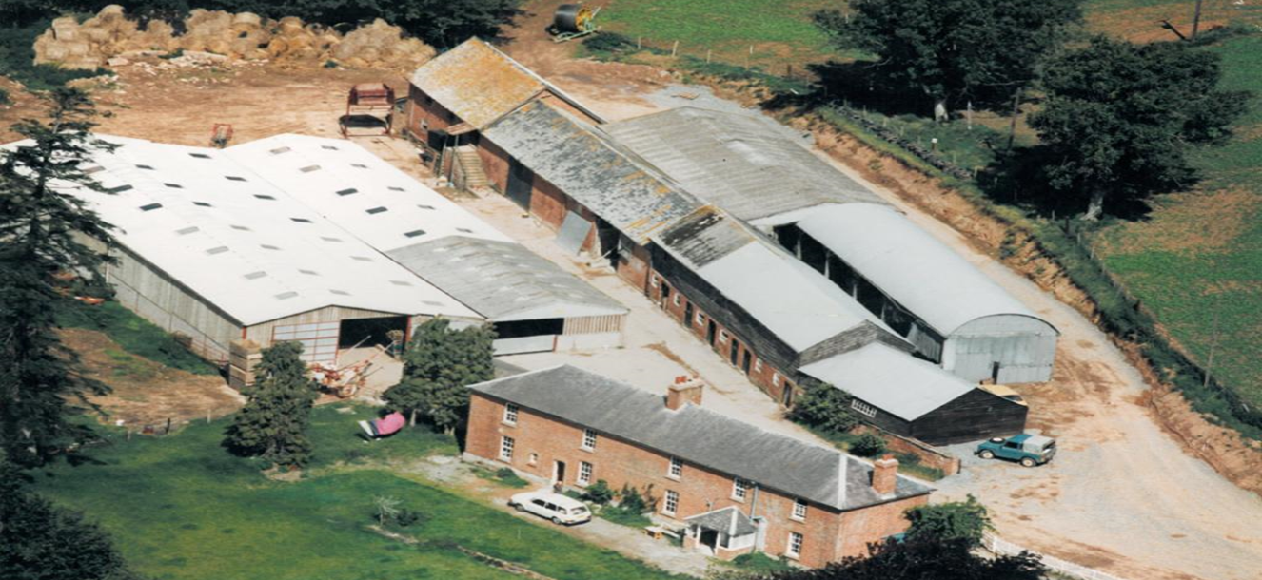
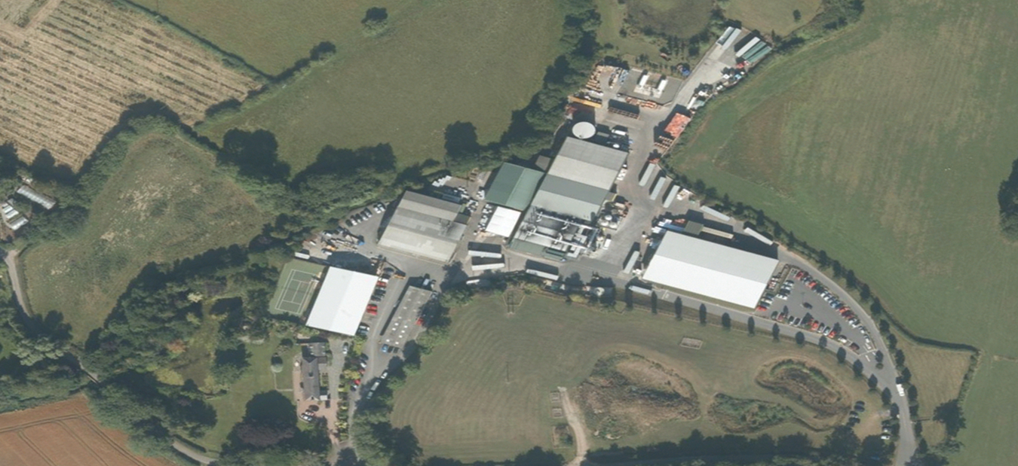
Welcome to Tyrrells Court Farm …Where the magic began

Slide 24
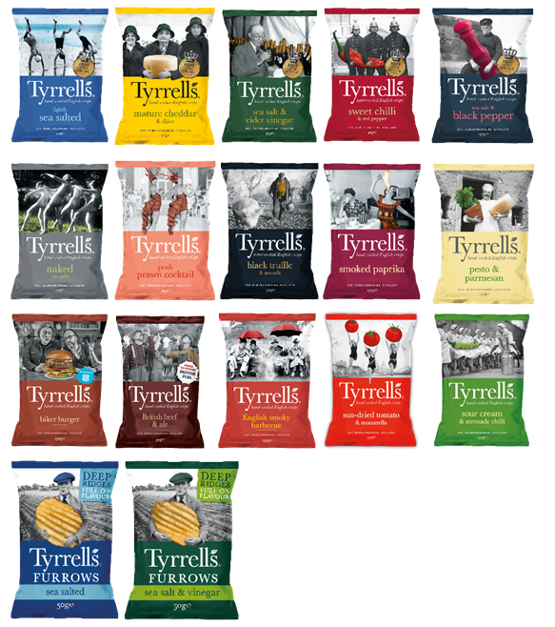

Key Site Statistics…..
Size:
Team - 145 staff, Operating 24/7, with 4 x 12 hour shift pattern
Output - c200T/wk using around 700T/wk
SKUs - 157
Distribution :
UK Grocery via DHL
Export c40 countries
Directs to customer depots
W&D / Van sales
Products:
Tyrrells “Hand Cooked Crisps” & also Furrows “Crinkle Cut Crisps”
Equipment:
12 batch fryers
1 x Robot with auto case erection
5 X Robots with manual case erection
Customers :
Grocery Multiples & Export

Slide 25
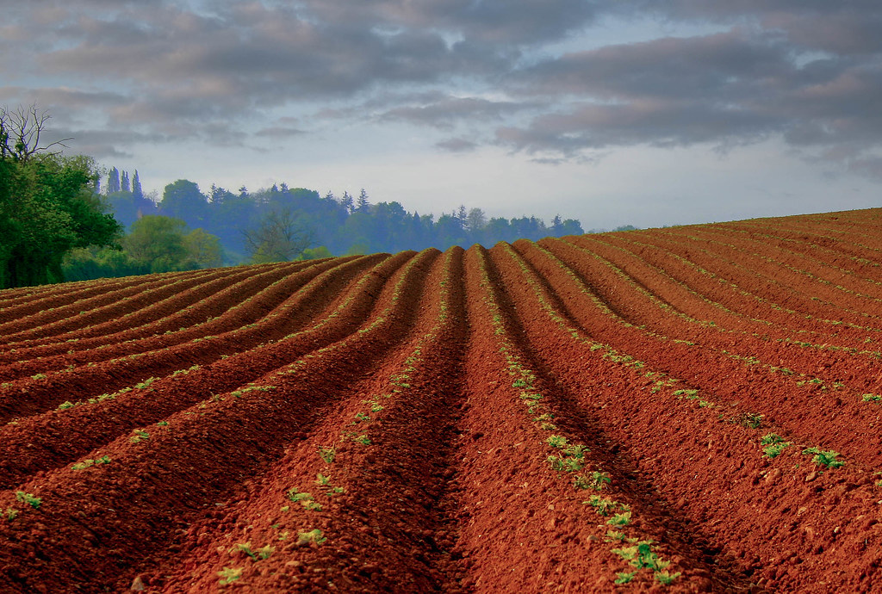
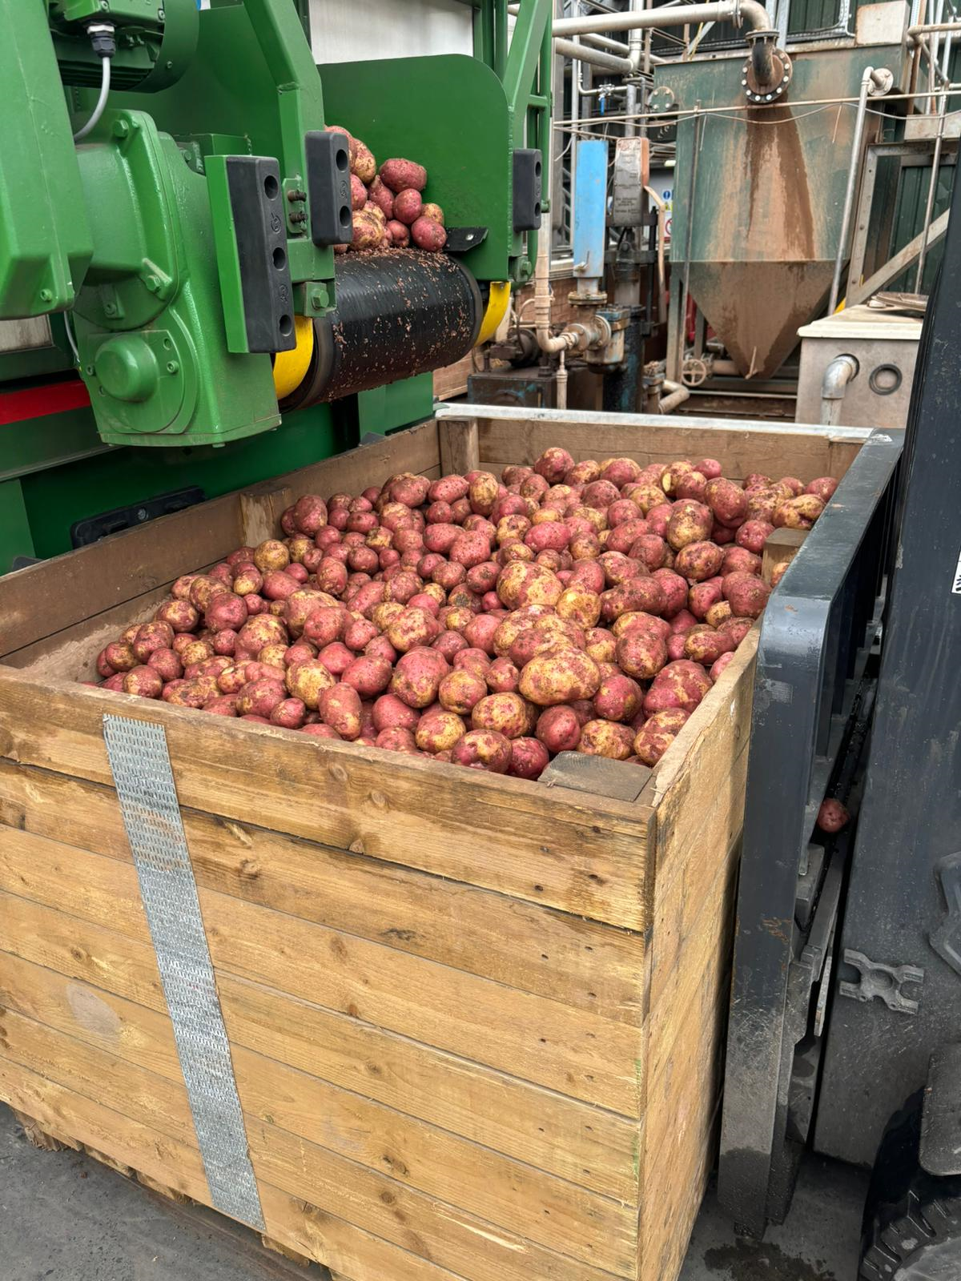
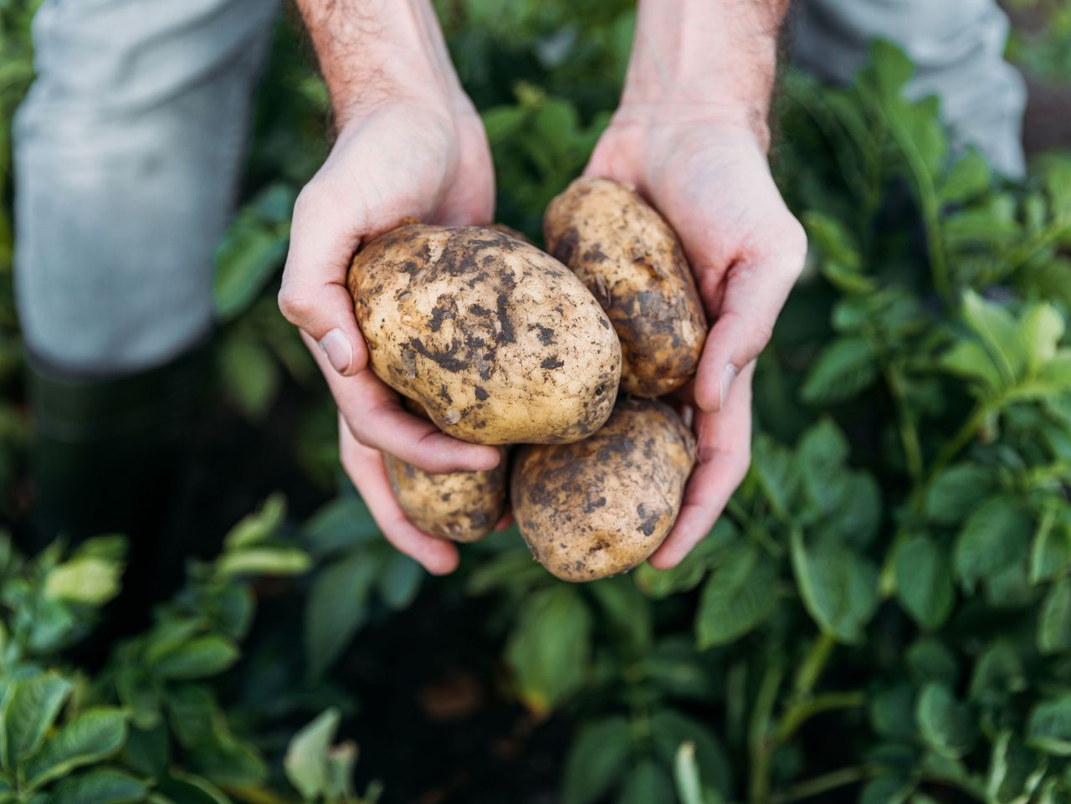
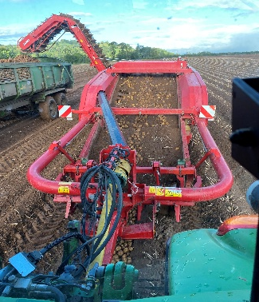
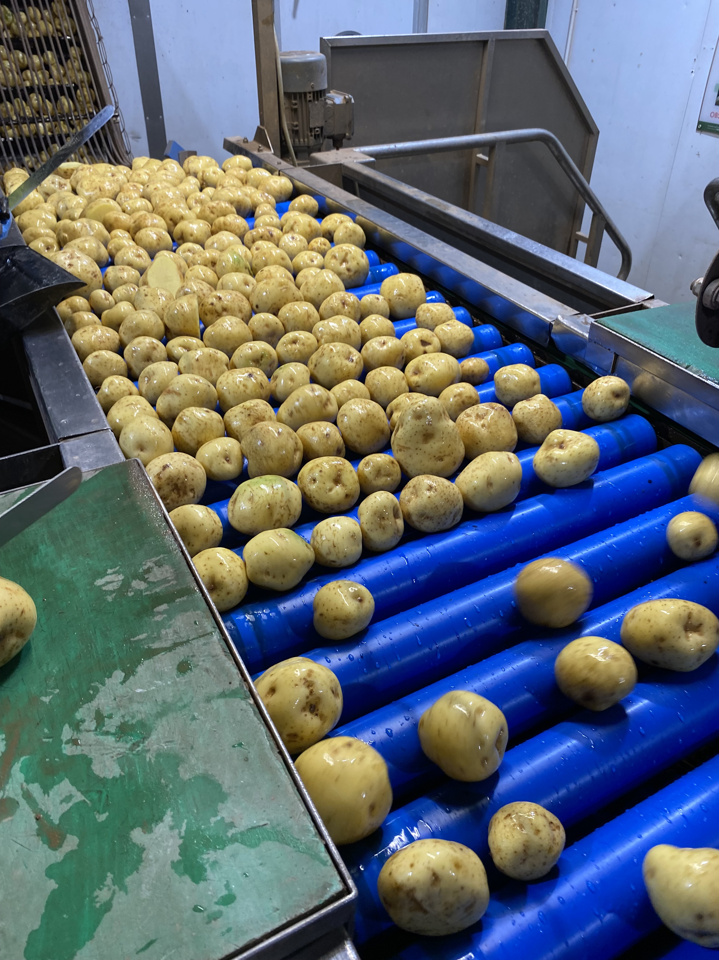
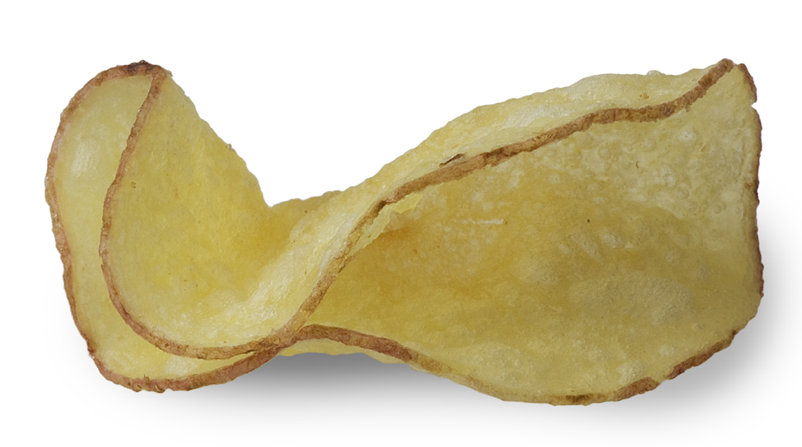


What makes Tyrrells Premium…
Planting the Tyrrells crop. Rich red Herefordshire soil is ideal for our growing potatoes | We use potato seasonal varieties across the year | We harvest between late July and October. | Growing relationships with local growers & farmers
Crisps are washed, sliced and hand cooked in sunflower oil | We leave the skins on and cook until they achieve our signature crunch & curl | We use specially selected authentic ingredients in our seasonings | We have won over 90 Great Taste Awards! We are committed to bringing the very best flavours to those who will truly love them.

Slide 26
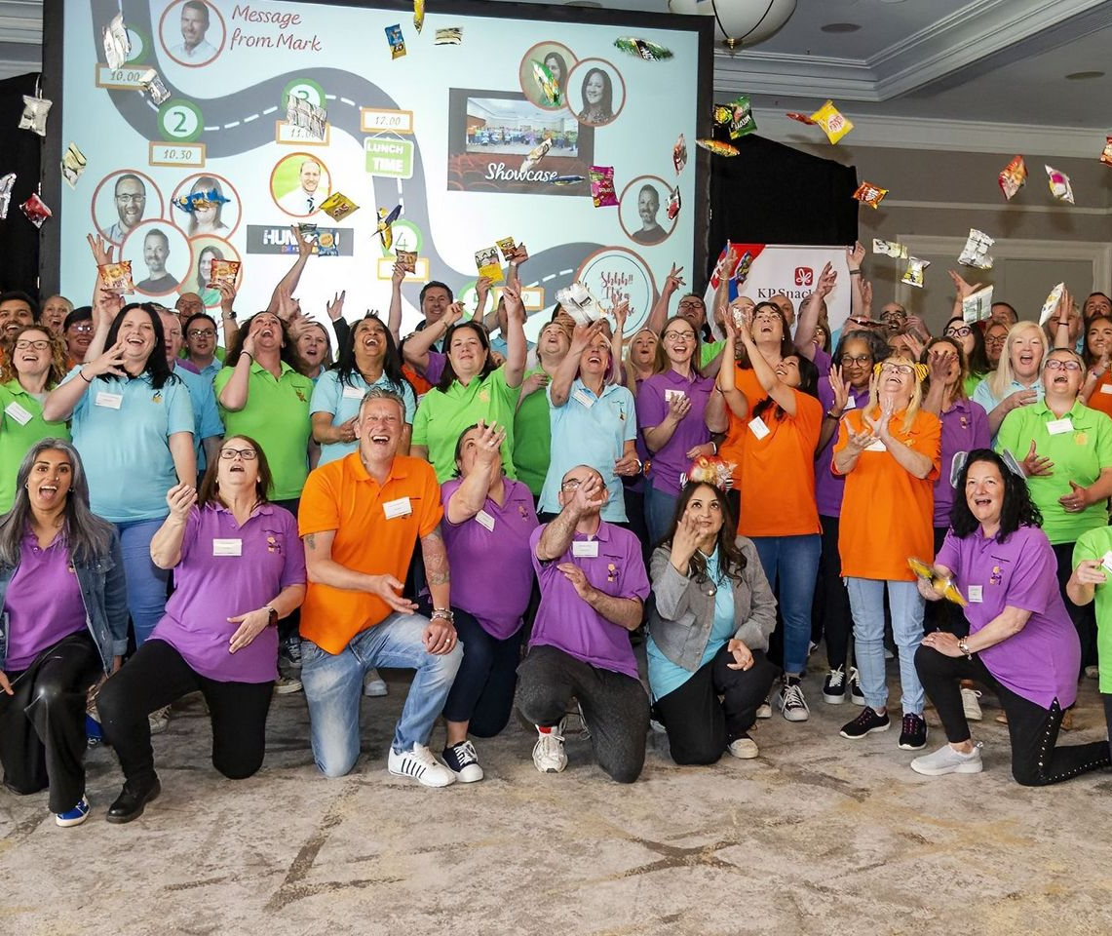
KP Values & Behaviours
Our V&Bs guide how we work every day and have helped us to create a great culture for the business, making it a fantastic place to work.
We have 10 V&B ‘Champions’ at KP Leominster who work to embed our V&Bs into every part of our business, at every site, every day.
We value our people
“We encourage everyone to be the best they can be”
We take personal ownership
“I am committed to making a difference”
We have a positive attitude
“Changing your attitude can change the world around you”
We achieve together
“We work as a team to make great things happen”

Slide 27
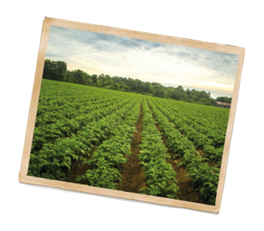
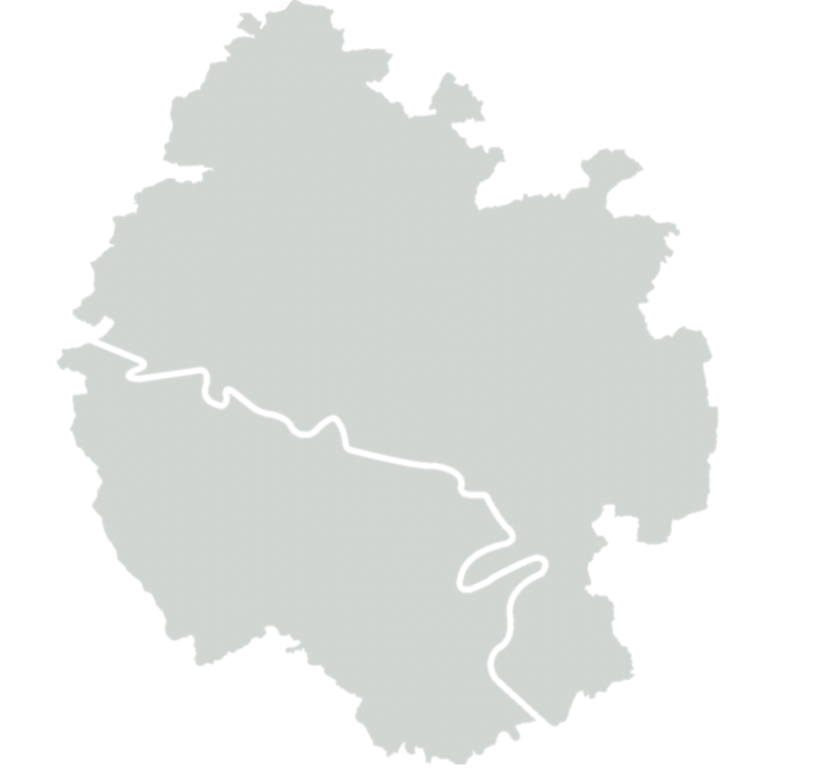

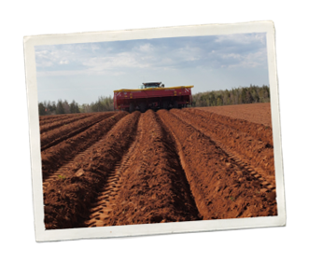
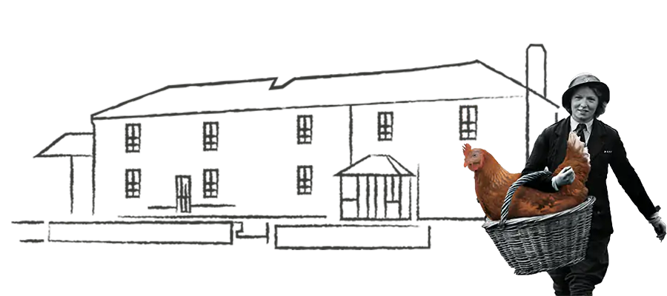


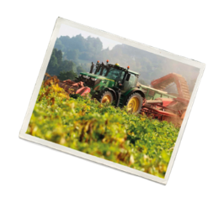

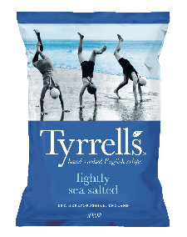
At Tyrrells, we believe that the better it’s made, the better it is…for everyone.
Local is better
Protecting nature,
wildlife and water
Supporting Sustainable
Agriculture
We are still based at our farm in Herefordshire where the rich red soil is ideal for growing potatoes. We try to source our potatoes from local famers to keep our food miles low.
Without nature and water we have no food. We’re working in partnerships with local water protection initiatives, re-wilding projects and nature groups (TBC) to increase levels of biodiversity in the UK and on our land
To ensure we can continue to grow the finest potatoes, we are supporting our farmer partners with a just transition to regenerative agriculture practice, improving soil health, carbon sequestration and technology to farm sustainably now and in the future
Reducing Waste
Waste is a huge problem in food. We’re working with our suppliers and with our factories to eliminate food waste, re-use / re-purpose waste and send zero to landfill
Minimising virgin plastic use
in our packaging
We’re investing in British farming to help farmers thrive
We’re reducing our
carbon footprint
We continue to reduce the amount of packaging we use in Tyrrells crisps and are incorporating more and recycled content. In the meantime, we’re working with industry to ensure recycling infrastructure is in place and looking ahead working on technologies to reduce single-use virgin plastic.
To ensure we have a farming community who can skillfully steward the land in the UK, we need to ensure we work with farmers and their communities investing so they can thrive for years to come
To meet our targets to reduce emissions by 50% by 2050? we plan to switch our energy supply to renewables wherever possible. We want to explore how we can make crisps using renewable energy sources, but to date this is not available. We are working with farmers to reduce emissions across all ingredients ie, potatoes oil, seasonings

Slide 28
At Tyrrells, we believe that the better it’s made, the better it is…for everyone.
Strategies
Actions
I
Supporting Sustainable
Agriculture
Protect soil health
Potato crop diversity
Cover crops on all farms
Trial natural fertilisers
Reduce tillage
Potato Crop innovation programme
II
Protecting nature,
wildlife and water
Protect and restore nature and biodiversity
Water reuse/conservation
In our farms – Regen ag focus on field margins
Beyond our farms – create a partnership eg: Woodland Trust
III
We’re investing in British farming to help farmers thrive
Make potato farming sustainable for future generations
Potato crop innovation
Whole crop
Close relationships / education
Support mental health
IV
We’re reducing our
carbon footprint
Use Renewable energy
Reduce logistics emissions
Introduce solar
Remove gas and use electric
DHL future plan (electric etc)
Direct deliveries
Reduce local routes (deliveries)

Slide 29
At Tyrrells, we believe that the better it’s made, the better it is…for everyone.
Strategies
Actions
Reduce
Reuse
Reduce bag size
Review case size
Remove tape use
Recyclable materials (PCR) on all range
V
Minimising virgin plastic use
in our packaging
Reduce raw potato wastage
Reduce edible waste
Make Flavours more efficient
Reduce changeover times
Take the whole crop from the farm
Eliminate clumping
Fewer allergens
SKU efficiency
Reducing Waste
VI

Slide 30


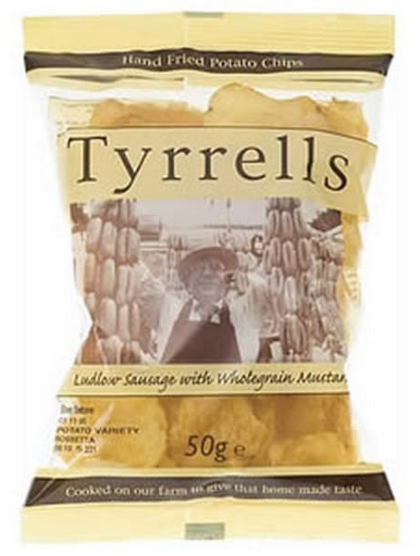
New Product Development

Slide 31
Intersnack Work System
The Intersnack Work System (commonly known as IWS) our standardised way of doing business together and operating our supply chain. It is designed to achieve and sustain breakthrough business results through 100% colleague engagement with a zero loss mindset.
How does it work?
Focuses on reducing losses through the supply chain
Not a system but a methodology (way of working)
Establishes the best way to do something, and then repeating it
Gives more decision-making and autonomy to those closest to the line... empowering them by giving them full ownership
Removes hierarchical delay and enables colleagues to make tomorrow better than today and create more happy snacking moments
Needs everyone's buy-in
Training and development support our people to be successful
Eliminates variation, duplication and waste
Breakthrough
Business
Results
Integration
The power of zero
defects and losses
The power of 100%
employee ownership
100

Slide 32

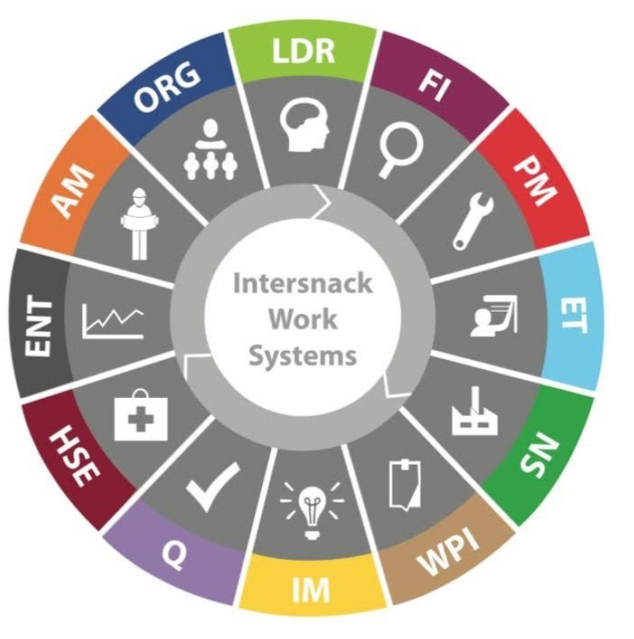
Intersnack Work Systems Journey
Notes:
In 2013 KP joined Intersnack, a global company. And in 2017 KP started the journey of IWS (Intersnack Working Systems). And in 2022 we Tyrrells started our journey of IWS.
This is about all sites having the same systems and processes, despite what country or city or site you are working in. IWS gives more autonomy and decision making to those closest to the line, aiming to achieve and sustain business results through 100% employee engagement with a zero-loss mindset.
All sites have a CBN – compelling business need which is our commitment to the wider business.
Here at Tyrrells Leominster our CBN is a blue tractor with a trailer – it was created by employees during the IWS launch day in May 2022.

Slide 33
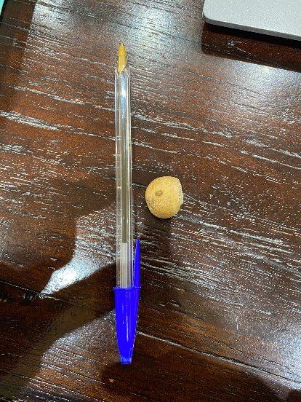
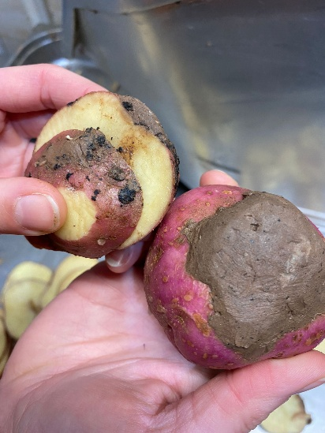
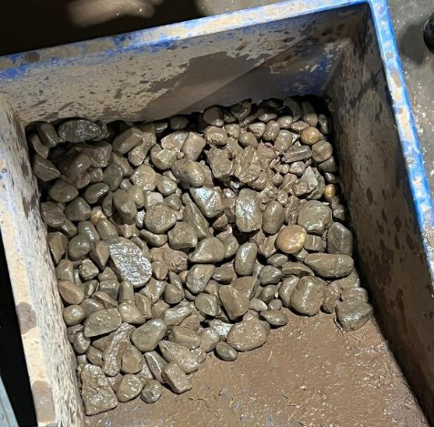





Potatoes
Stones
Pot sizing
Mud
Varieties

Slide 34




Floods/ weather
3 floods in 2025 so far
If water breaches our flood defences, factory is closed as no product can safely leave factory & routes home for staff are starting to be cut off
Investment in flood defences: £c100k
Cost of manufacturing stop, service, product write off, damage to buildings & infrastructure & loss of orders

Slide 35
Recruitment
Positives | Challenges
Great brand | Rural location
Brilliant culture | Public transport links
Growth opportunities | Competition for talent in the area
Job security & KP Benefits | Pay impacted by Competition for labour
In the last 12 months, we have had over 600 applications for our Production Operator roles
  c.60% rejected due to skills and experience
  Further 60% (141) invited for video interview
  60% of these are no-shows, 20% invited to on-site interview
  78% offered a role

Slide 36



Thank you
for listening!
Any questions?

Slide 38

Rhian Caffull
Founder and Chief Eggxecutive Officer

Slide 39








Slide 40


Slide 41


Slide 42


Slide 43


Slide 44


Slide 45


Slide 46


Slide 47


Slide 48


Slide 49


Slide 50


Slide 51


Slide 52


Slide 53


Slide 54


Slide 61
Thank you for attending!
If you would like to go on the venue tour,
please wait at the registration desk.

